Slide 1

Data Analytics

Slide 2
Agenda
Data Analytics Definition
Steps of Data Analytics
Types of Data Analytics
Subsets of Data Analytics
Applications of Data Analytics
Concluding Remarks

Slide 3
What is Data Analytics?
Analytics is the use of:
Data
Information technology
Statistical analysis
Quantitative methods
Mathematical or computer-based models
To help managers:
Gain improved insight about their business operations
Make better, fact-based decisions.

Slide 4
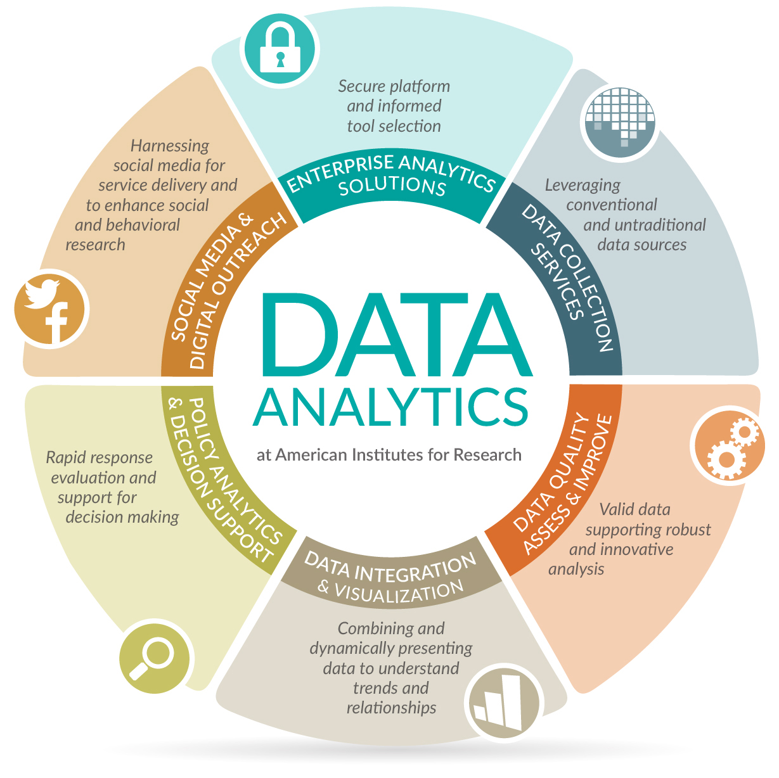

Slide 5
1
Goals setting
Vital, understandable, simple, short, and measurable goals
2
4
5
6
3
Setting priorities for measurements
Decide what to measuring, and what methods to use for measure it
Data gathering
Available datasets, recording/generating data
Data cleansing
Outlier rejection, missing values interpolation, data structuring
Data analysis
Data mining, business intelligence, data visualization, exploratory data analysis
Precise results’ interpretation
Checking whether they are helpful in meeting initial objectives, results limiting, or inconclusive

Slide 6

Python
Object oriented language
Interpreted language
Supports dynamic data type
Independent from platforms
Focused on development time
Simple and easy grammar
High-level internal object data types
Automatic memory management
It’s free (open source)

Slide 7

MySQL is a very popular, open source DBMS
MySQL databases are relational
Very fast performance and reliable.
MySQL is compatible with standard SQL
Free (much cheaper than Oracle!)
Each student can install MySQL locally.
Multi-user access to a number of databases offered
Easy to use Shell for creating tables, querying tables, etc.
Easy to use with Java JDBC
MySQL is frequently used by PHP and Perl
Commercial version of MySQL is also provided (including technical support)
Works on many different platforms

Slide 8

Power BI is a Data Visualization and Business Intelligence tool that converts data
from different data sources to interactive dashboards and BI reports.
Power BI suite provides multiple software, connector, and services .
Power BI desktop, Power BI service based on Saas, and mobile Power BI apps
available for different platforms.
These set of services are used by business users to consume data and build BI
reports.
Power BI desktop app is used to create reports, while Power BI Services (Software
as a Service - SaaS) is used to publish the reports.
Power BI mobile app is used to view the reports and dashboards.

Slide 9

It easily helps in capturing audiences’ attention because of its interactive clickable elements,
colours, images, videos, etc. making the presentation more memorable.
Users can delve further into data visualizations, charts, and graphs in interactive slideshows
for data-driven presentations.
To acquire deeper insights, they might filter data or zoom in on particular data points.
Interactive slideshows possess features like surveys and quizzes to collect feedback and gauge
audience comprehension in real-time, which can be useful for training or instructional purposes.
Presenters can adapt their information to their audience’s demands by using interactive
slideshows. Users can take their own route through the content by concentrating on the
subjects that are most interesting or important to them, creating a more individualized
experience.

Slide 10

Advanced Excel
MS-EXCEL is a part of Microsoft Office suite software.
It is an electronic spreadsheet with numerous rows and columns, used for organizing data,
graphically representing data(s), and performing different calculations.
It consists of 1048576 rows and 16384 columns, a row and column together make a cell.
Each cell has an address defined by column name and row number example A1, D2, etc.
Microsoft Excel is a software application designed for creating tables to input and organize data.
It provides a user-friendly way to analyze and work with data.
The skill ceiling is high, which means that you can do more advanced things as you become
better.
Excel organizes data in columns and rows and allows you to do mathematical functions.
It runs on Windows, macOS, Android and iOS.

Slide 11
THANK YOU

